Slide 1


THE DEVELOPMENT AND DEPLOYMENT OF CLEAN ENERGY TECHNOLOGIES – CASE STUDIES
By
SAMUEL WARA
@
AI4CE WORKSHOP
SEPTEMBER 28, 2020

Slide 2
PRESENTATION SUMMARY
THE ISSUES/CHALLENGES
THE TECHNOLOGIES
THE DEVELOPMENT, DEPLOYMENT & USE
THE EXPECTED OUTCOME
ENGINEERING STRATEGIES FOR MITIGATING AND ADAPTING TO CLIMATE CHANGE

Slide 3
THE DEVELOPMENT, DEPLOYMENT , USE & OUTCOMES
Improved cooking methods
Energy efficiency/advocacy/behavioural change (technical/non technical/cost/zero cost)/Energy efficient technologies
Energy mix scenarios/fuel requirement reduction for processes & needs
Carbon capturing/storage/use
We shall dwell on 1 and 2 after reviewing what some Nigerians have done to read, cook, do business etc?!
A Vision in Motion!

Slide 4
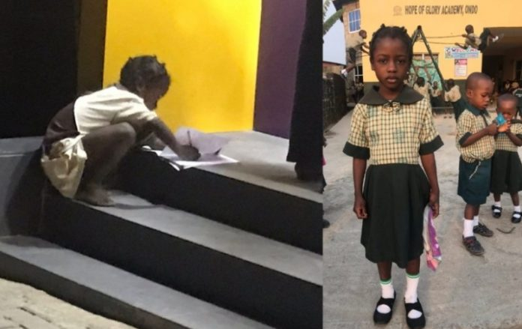
Girl spotted using ATM light for assignment gets FCMB scholarship
The seven-year old girl, Fathia Dele Rasheed, spotted last week using FCMB’s ATM gallery light in Ondo state to do her school assignment has been given a full scholarship by the management of the bank.
Dele, a primary three pupil of Hope Glory Academy, Yaba, Akure in Ondo State, was last week pictured in the night using FCMB ATM gallery light to do her Mathematics home work.

Slide 5
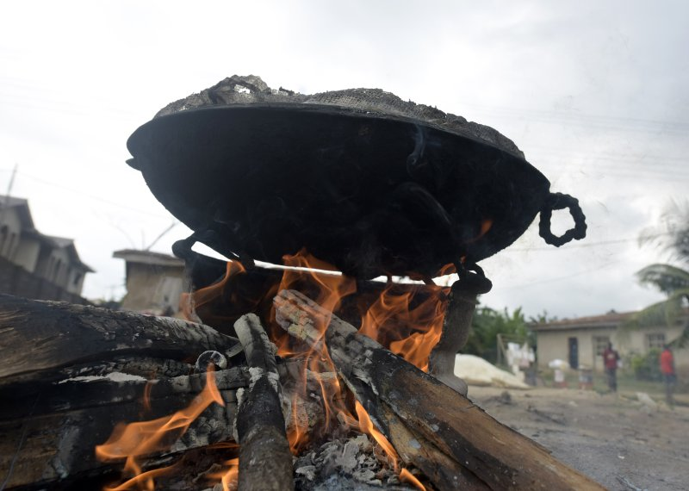
Firewood, seen here on August 22, 2015, is largely used for cooking in sub-Saharan Africa.
Pius Utomi Ekepi—Getty Images
Many women in Nigeria suffer ailments resulting from the use of firewood. The World Health
Organization states that “Over 98,000 Nigerian women die annually from use of firewood.
If a woman cooks breakfast, lunch and dinner, it is equivalent to smoking between three and 20 packets of cigarettes a day.”
In Nigeria, about 72% of the population depends on fuel-wood for cooking
90% of the chopped down trees in Africa are used for woodfuel or charcoal.

Slide 6
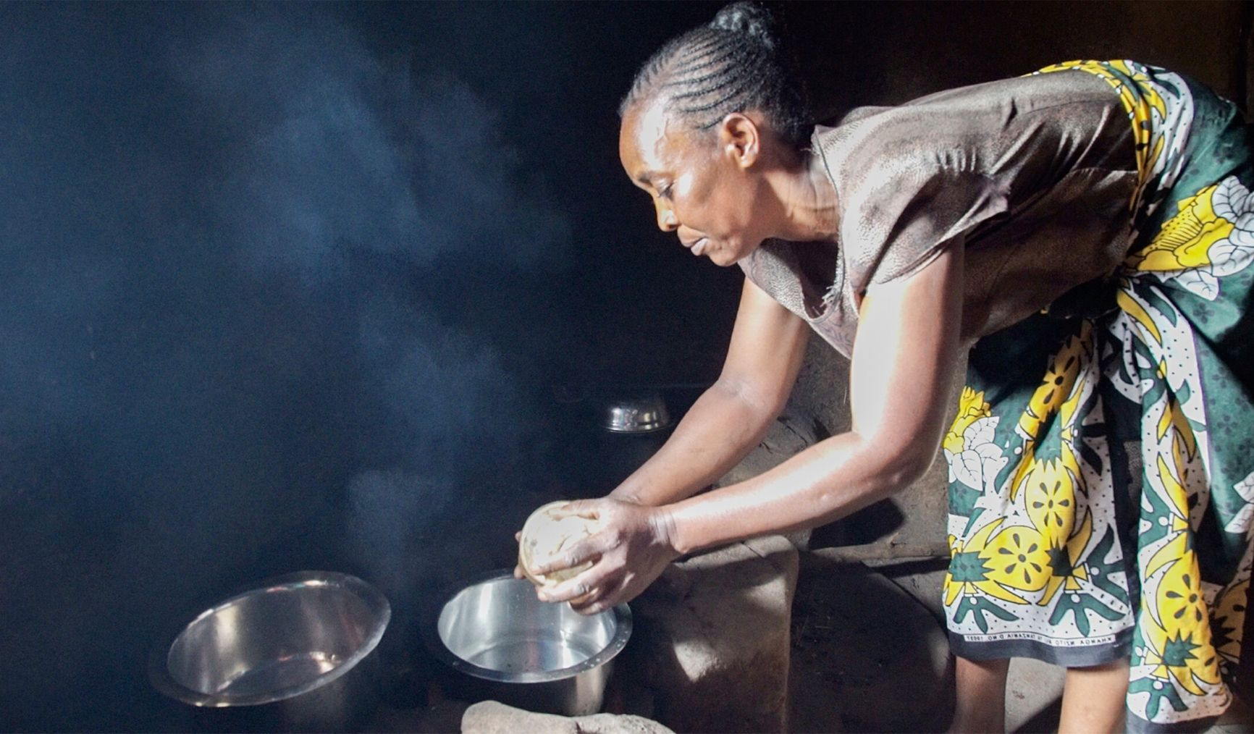
Traditional cooking methods are putting women at risk
Three billion people in the world face seared eyes from burning wood every day.
95% of whom are from developing nations in Africa and Asia

Slide 7
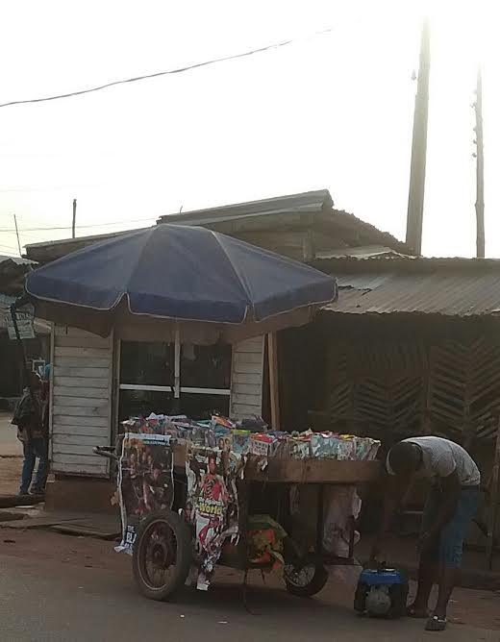
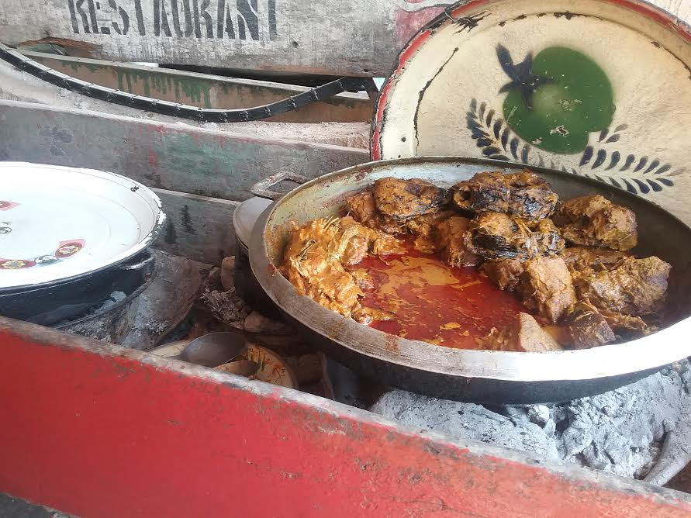
FOOD HEATING AND CD SELLING

Slide 8
OUR STORY SO FAR
I shall speak through the various picture and demonstrate practically in the available time our short walk to contribute in
the quest for zero carbon energy,
sustainable environment,
access to electricity,
clean cooking,
waste to Energy,
waste to wealth
Capacity building/advocay etc

Slide 9
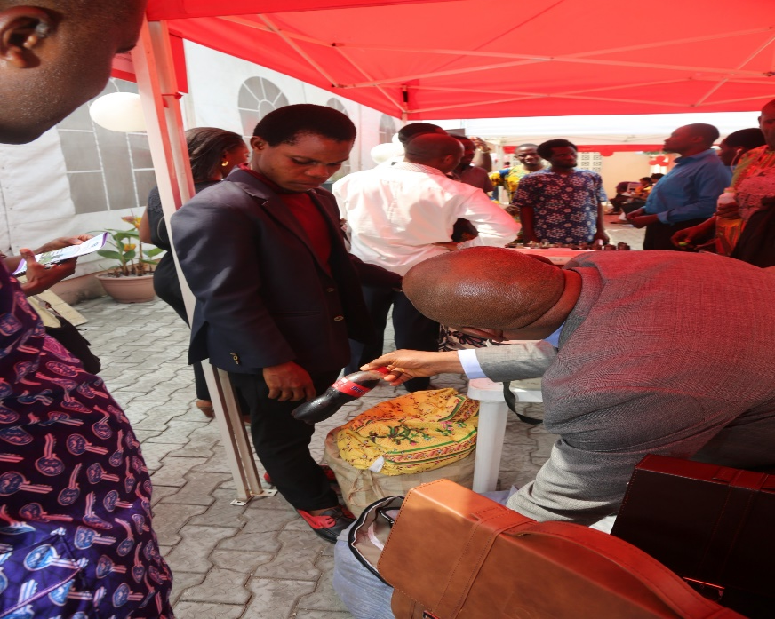
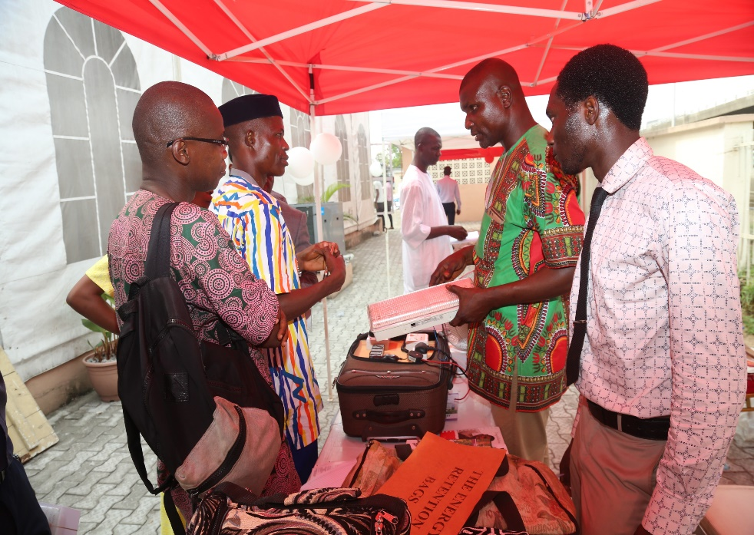
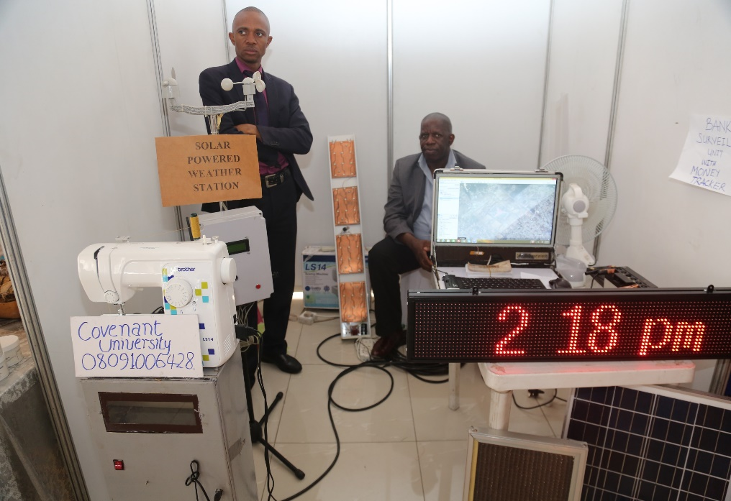
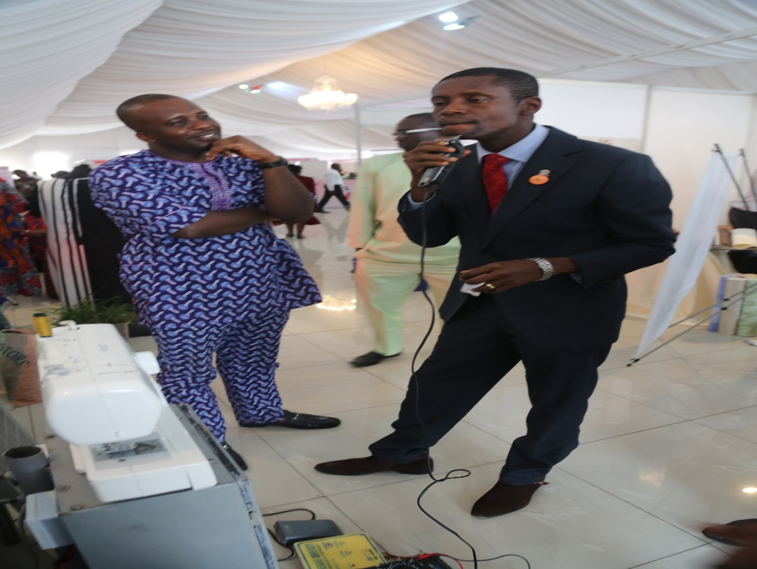
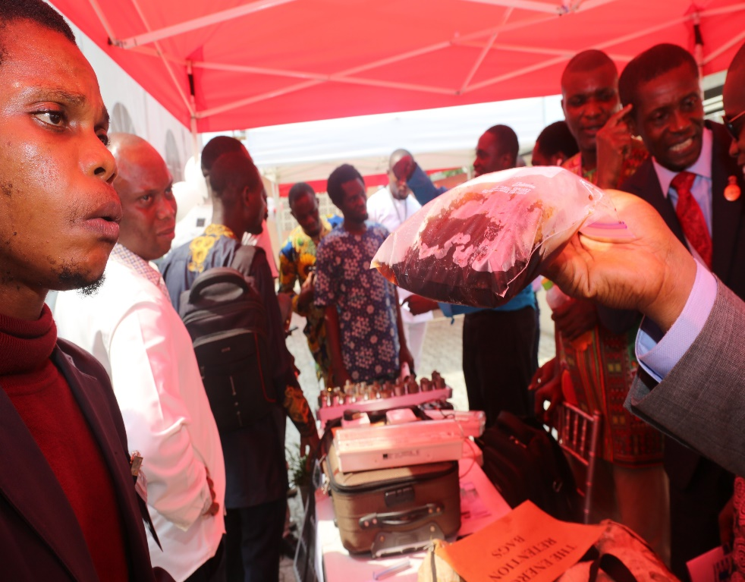
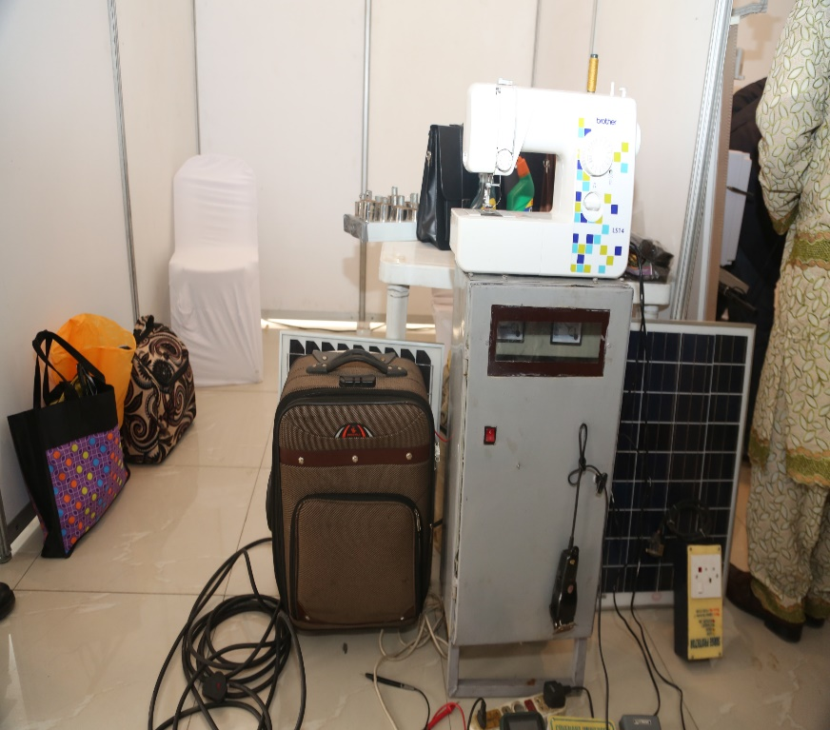
THE DEPLOYMENT & USE
A Vision in Motion!

Slide 10
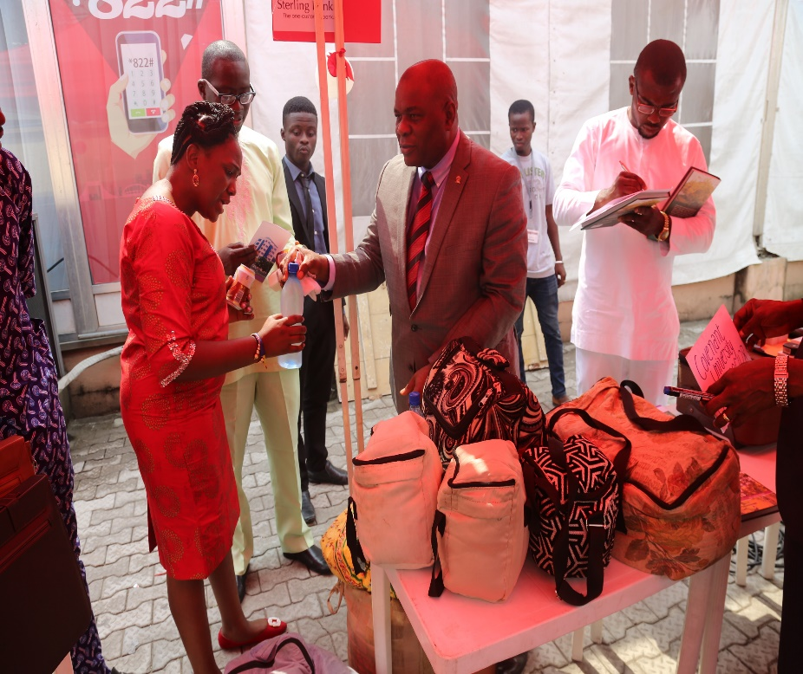
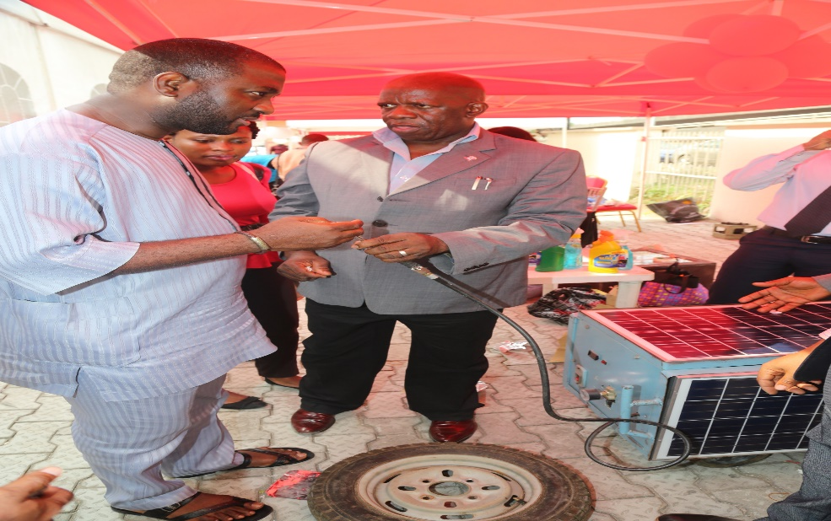
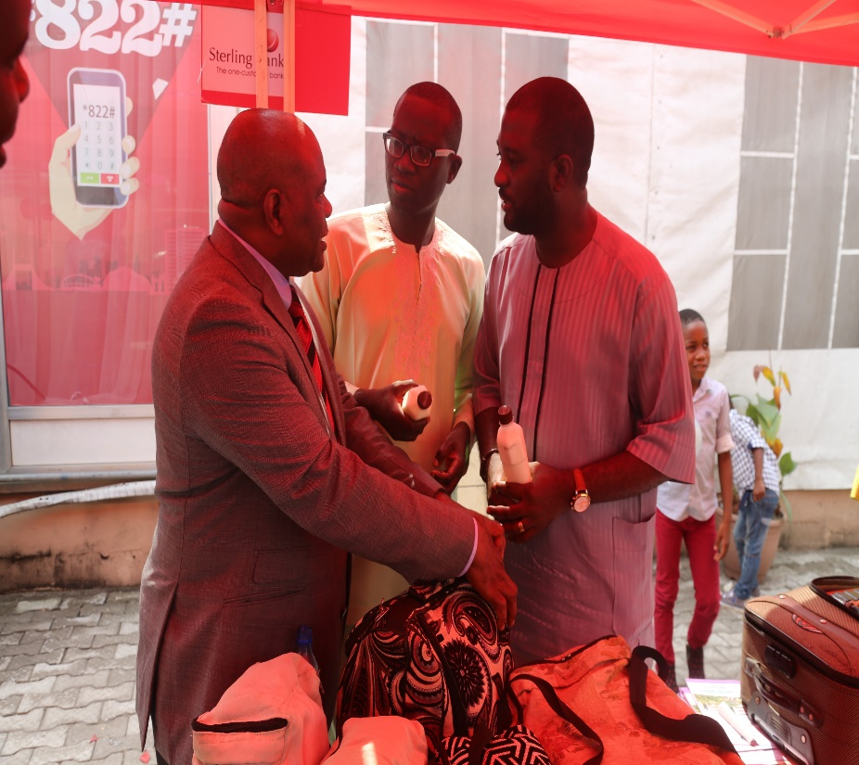
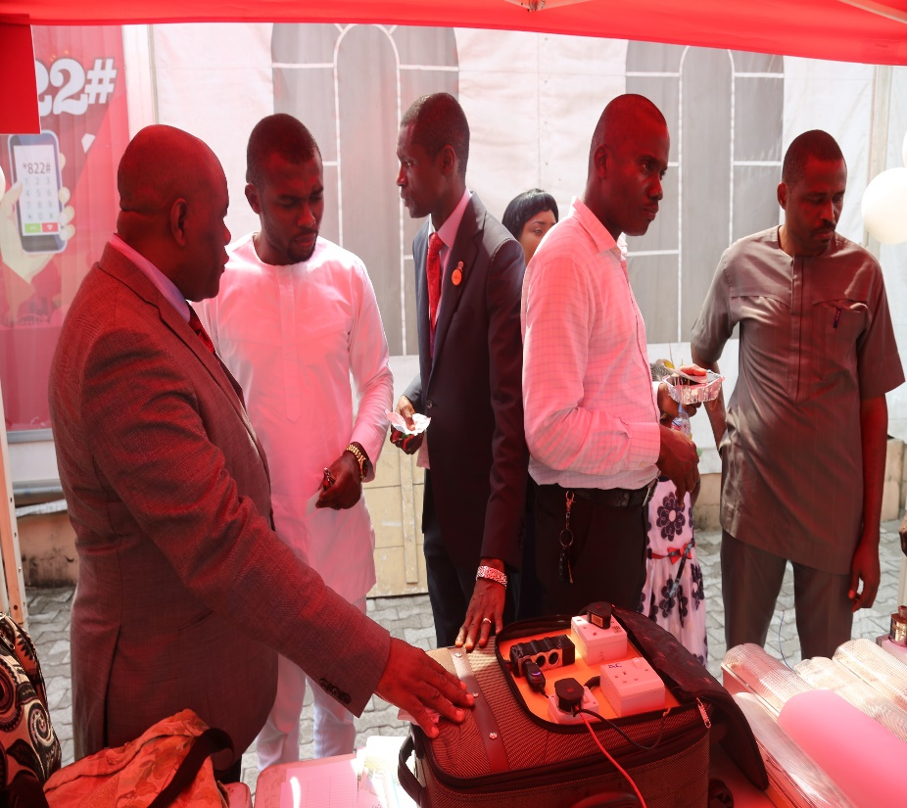
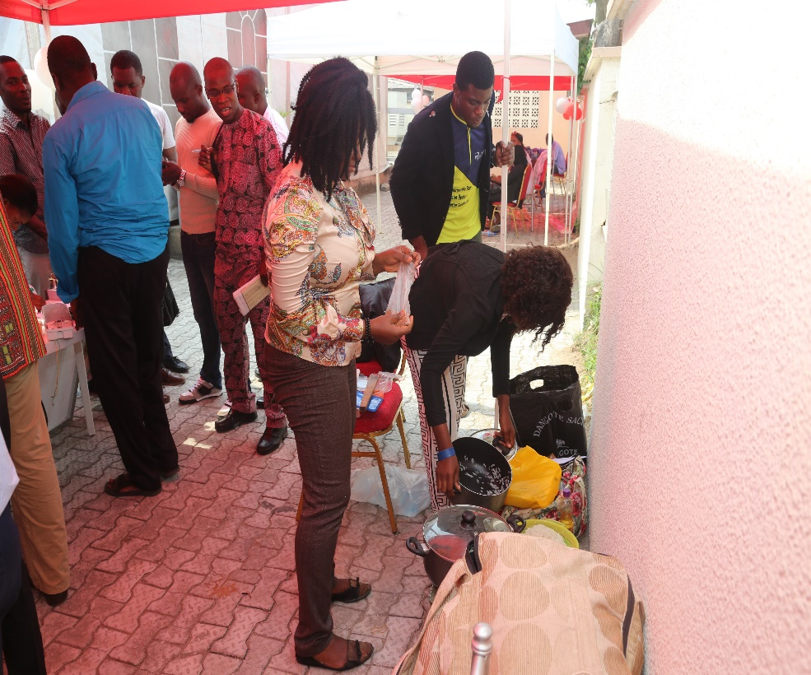
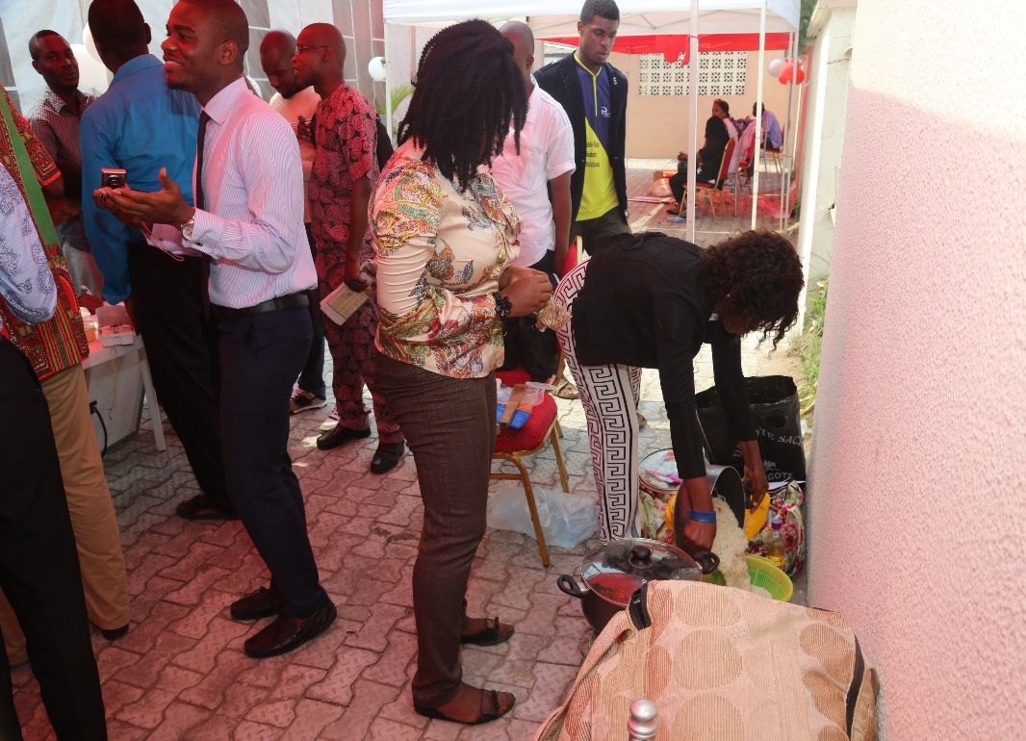
THE DEPLOYMENT & USE
A Vision in Motion!

Slide 11
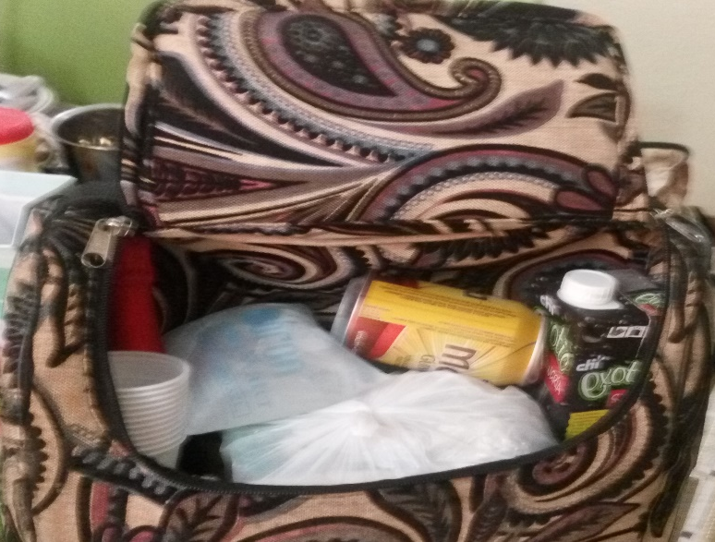
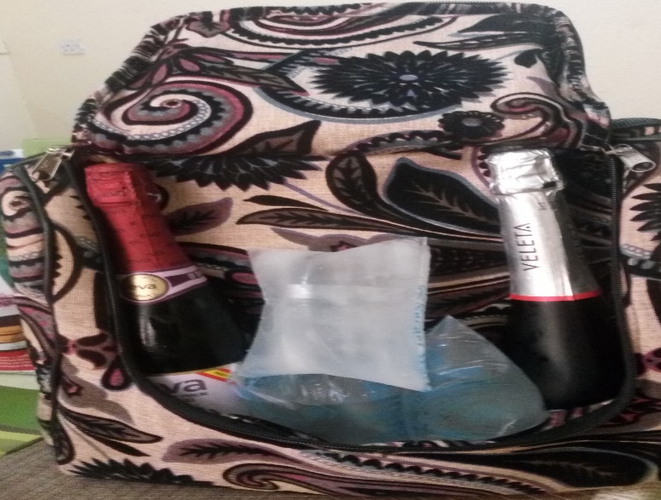
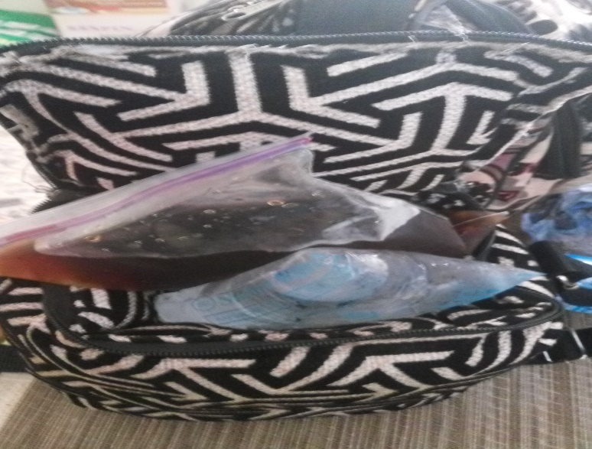
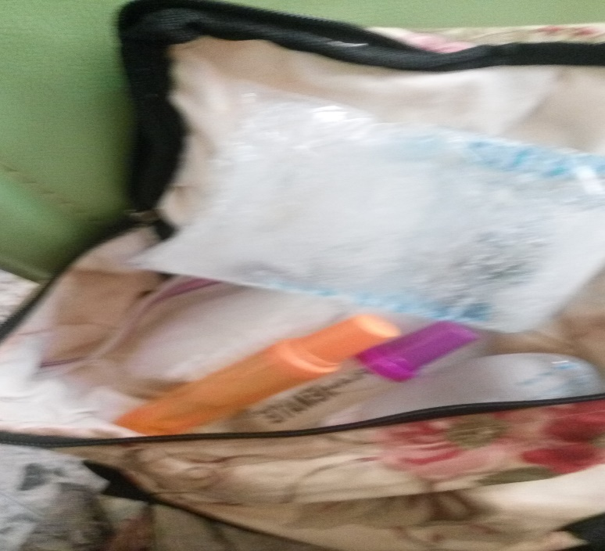
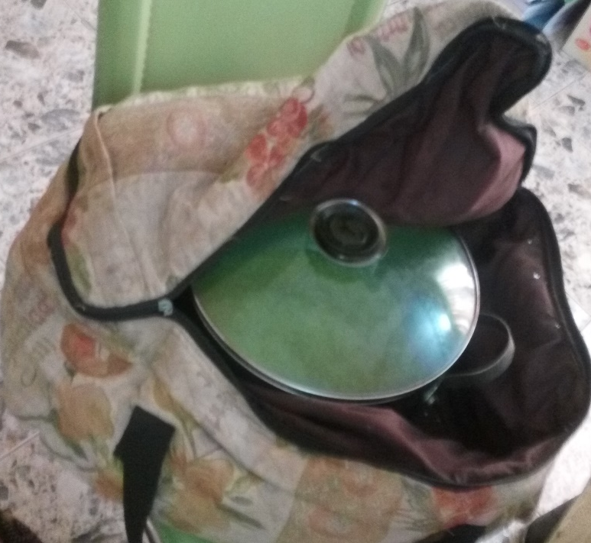
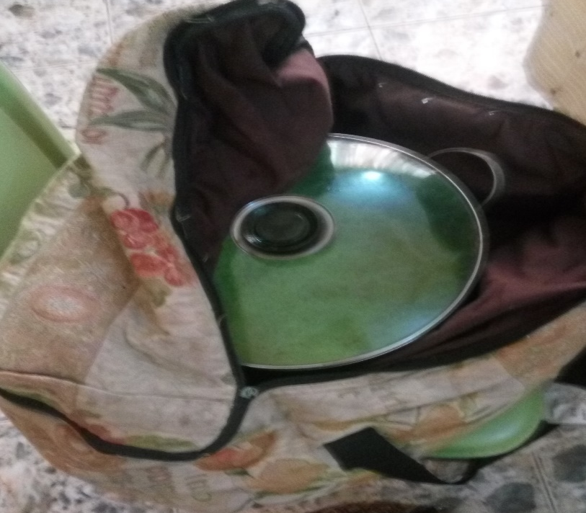
THE DEVELOPMENT, DEPLOYMENT & USE
A Vision in Motion!

Slide 12
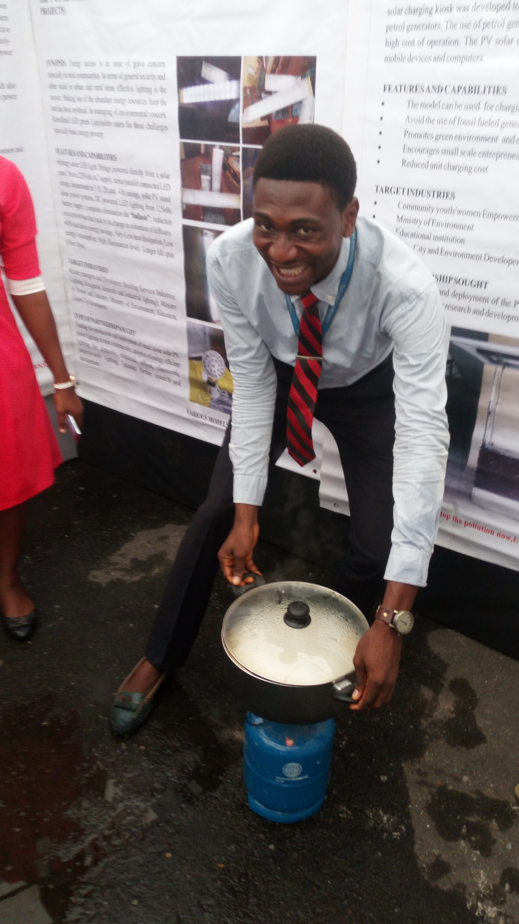
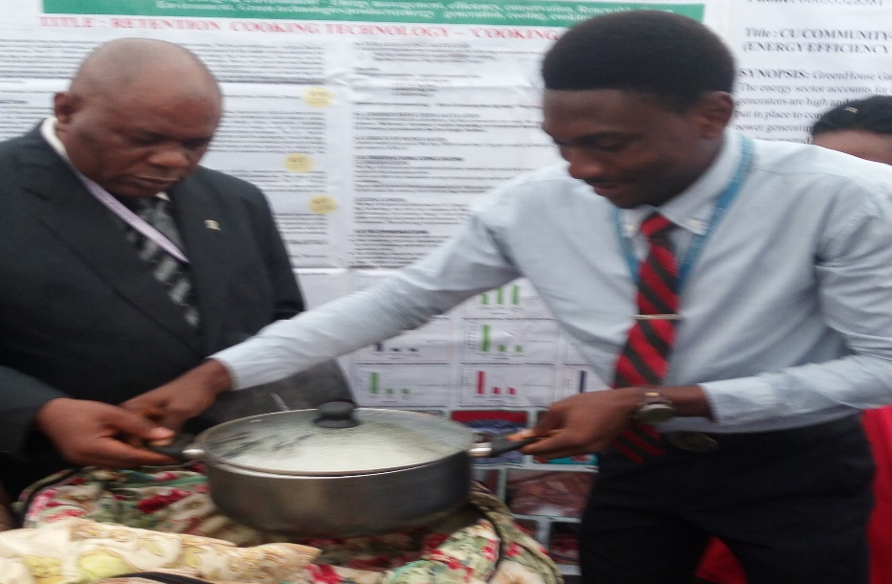
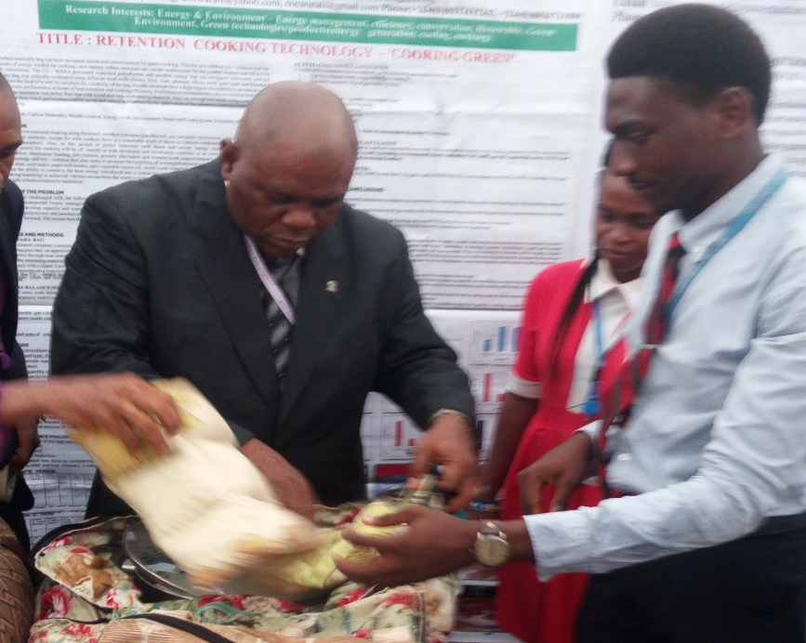
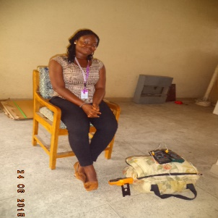
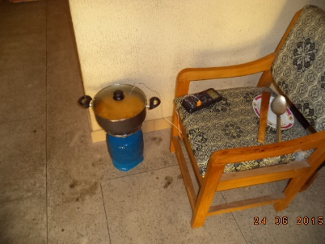
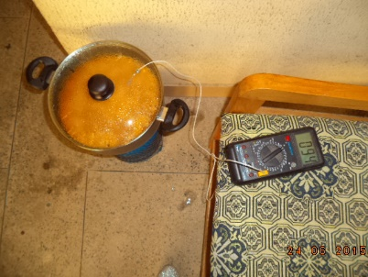
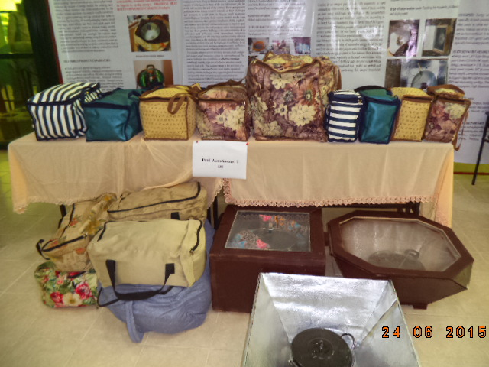
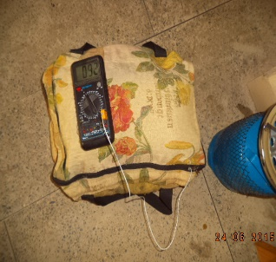
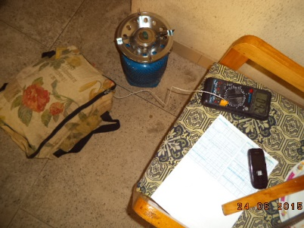
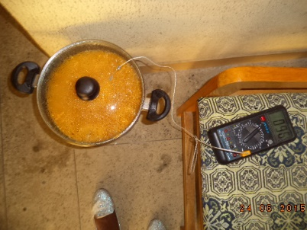
COOKING PROCESS, COOKER MODELS

Slide 13
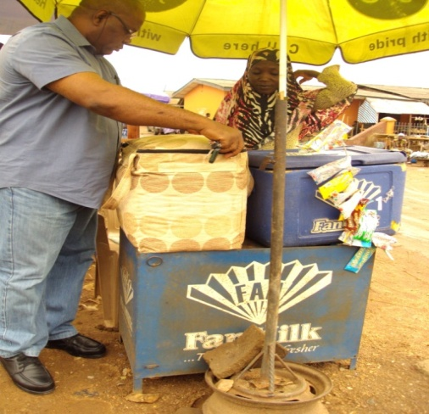
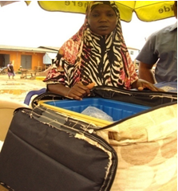
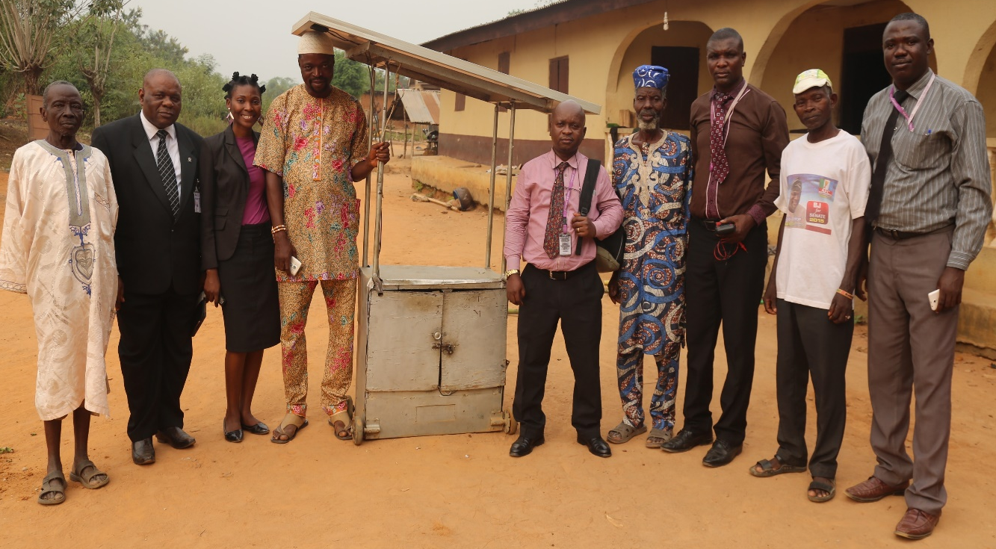
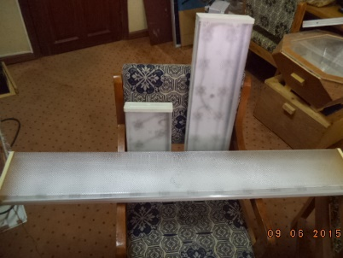
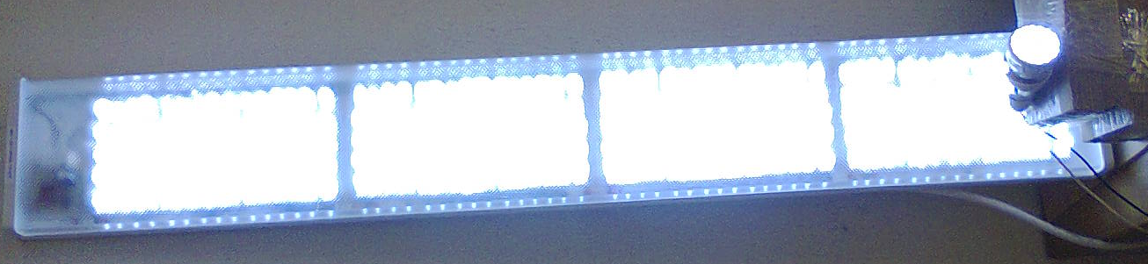
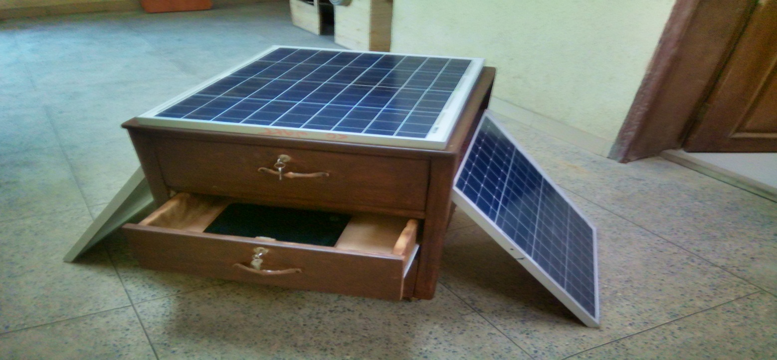
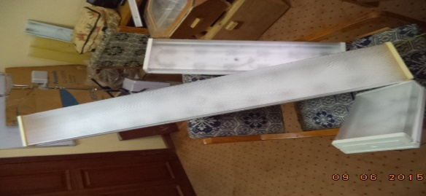
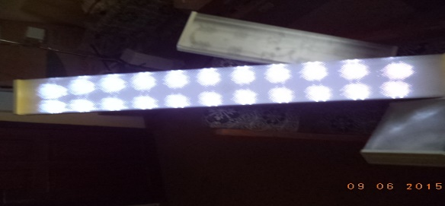
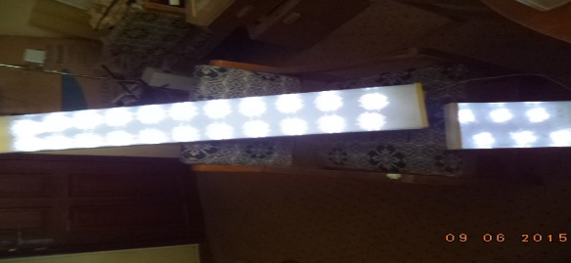
THE DEVELOPMENT, DEPLOYMENT & USE – AGRIC, HEALTH, SPORTS, MSMSEs/hawkers, caterers etc
A Vision in Motion!

Slide 14
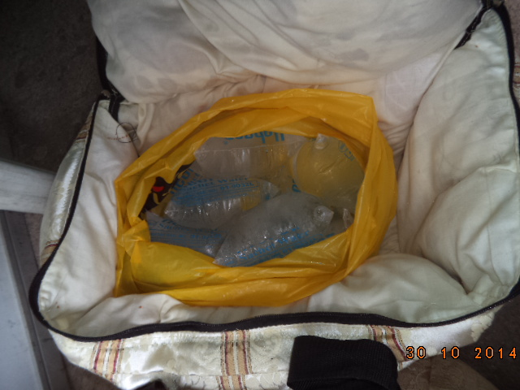
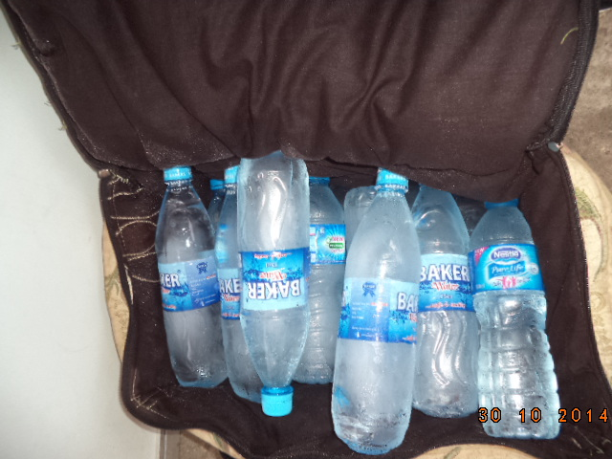
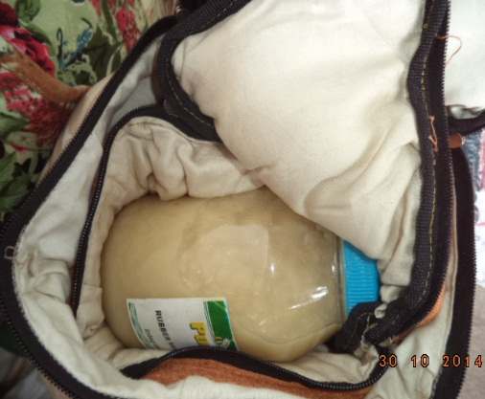
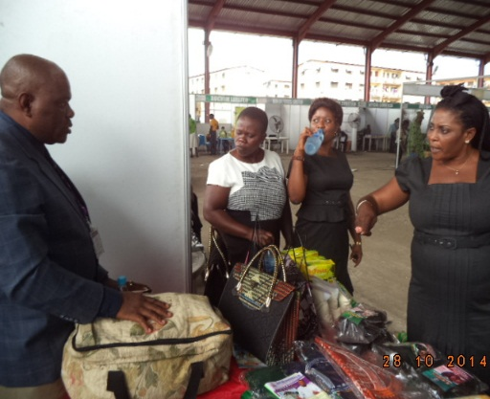
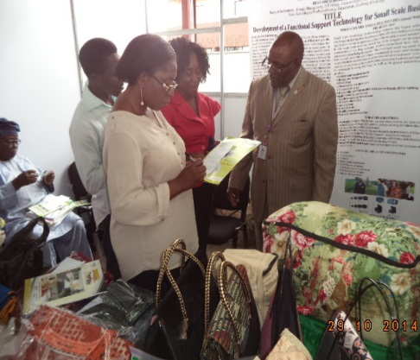
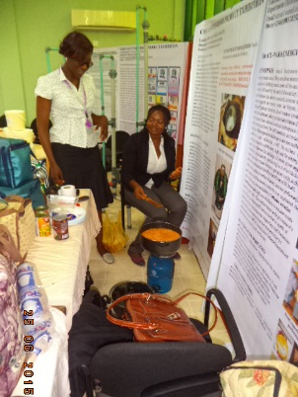
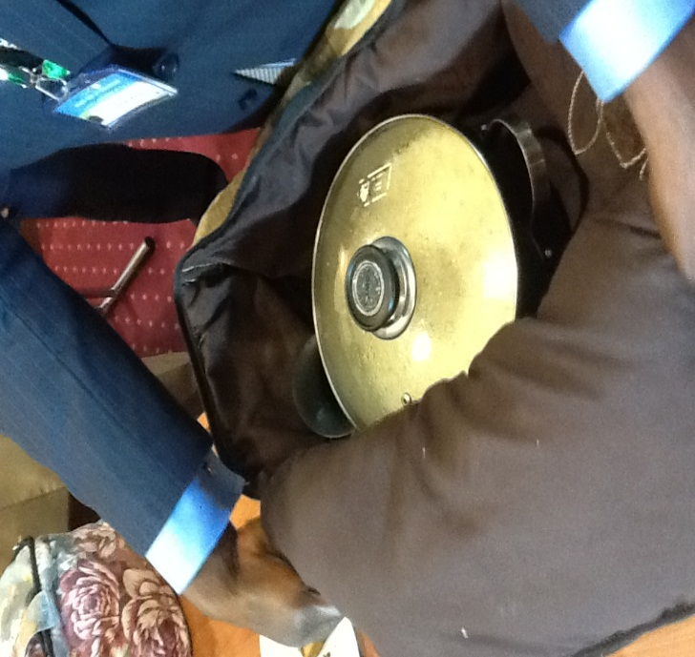
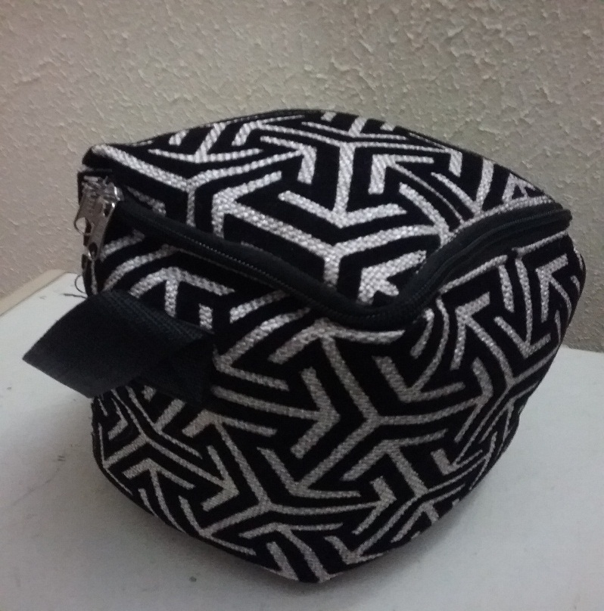

EXPLORER ENERGY RETENTION BAGS

Slide 15













SOLAR COOKER MODELS

Slide 16




SOME MODELS OF LOW COST ENERGY EFFICIENT COOKERS

Slide 17


OUR RANGE OF EXPLOITS WITH BAGS & PRODUCT DEVELOPMENT

Slide 18


OUR RANGE OF EXPLOITS WITH BAGS & PRODUCT DEVELOPMENT

Slide 19


OUR ROOFTOP INSTALLATION AND CAPACITY BUILDING EXPERIENCE

Slide 20








ABUAD DOUBLE LIGHT PROJECT – OLOGUNJA & IDODO VILLAGE FARM SETTLEMENTS

Slide 21






ABUAD PICOLUMINAIRE PROJECT
TEAM LEAD: S. T. WARA
Development Director: Ibitoye

Slide 22
RET PRODUCT DEVELOPMENT & CAPACITY DEVELOPMENT PROJECT
INVERTERS
FUELLESS GENERATORS
SOLAR PV GENERATORS
LUMINAIRES
STABILIZERS
RET BAGS
ETC
HOMES
HOSTELS
CYBER CAFES
VIEWING CENTERS
BARBING SHOPS
TAYLOR SHOPS
PHYSICS LABS
CBT CENTERS ETC

Slide 23
GOING FORWARD/CONCLUDING REMARKS
We have shown that it is possible to adapt and mitigate energy use to manage climate change and global warming
We can provide efficient alternatives for clean cooking, lighting, heating etc
We have developed products and tested them
We have initiated community projects
We urge AEIRG/AI4CE to partner with us and fund our projects and deploy them in communities, build capacity by training youths and women groups as well as college kids; develop competitions etc
We thank the organisers for this opportunity and pledge our readiness to promote all we know at a fee.

Slide 24

THANK YOU FOR LISTENING

Slide 25
CONTACTS
+2348056731904
+2348037415262
docwarati@gmail.com
warast@abuad.edu.ng
Linkedin profile: www.linkedin.com/in/samuel-wara-7a99a048
Researchgate: https://www.researchgate.net/profile/Samuel_Wara_Tita
ORCID:http://orcid.org/0000-0001-6455-7375

Slide 26
ABOUT THE AUTHOR
Professor of Power & Energy Systems
Energy Management Consultant
Department of Electrical and Computer Engineering, Afe Babalola University, Ado - Ekiti(ABUAD)
Chief Staff Advisor, ABUAD Salt Valley Associates (ASVA)
Chairman, College of Engineering Consultancy Committee, ABUAD
Chairman, ABUAD Plastic Recycling Committee
Former Dean, School of Post Graduate Studies, Covenant University,
Ota, Nigeria
Former Director, Research, Innovation & Discovery, Covenant University, Ota, Nigeria
Former Team Lead, Renewable Energy Research Cluster, Covenant University, Ota, Nigeria
Former Chairman, Equipment Committee, Covenant University, Ota, Nigeria
Former Founding/Pioneer Dean, General Abdusalami A. Abubarkar College of Engineering, Igbinedion University Okada
Former Director, Energy/Product Development Center, Igbinedion University Okada
National merit award - Chevalier (Knight) of The Republic of Cameroon
Initiator, Campus Energy Group

Slide 27
Acknowledgements
Mr. Ibitoye Oladapo
Mr. Peter Ohai
Mr. Edmond Enyinnia
Mrs. H. U. Wara

